Slide 1
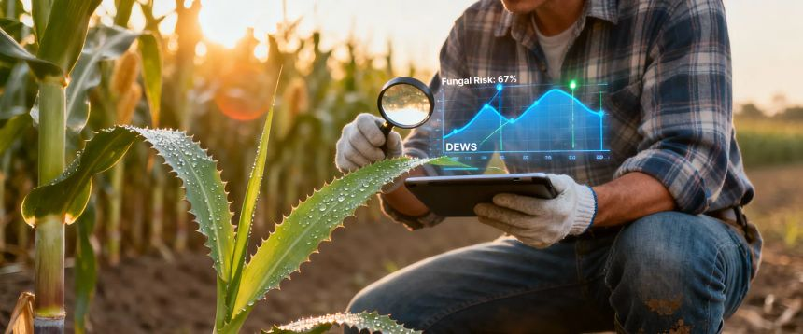

AI-Based Crop Recommendation System
Name : Nithin Thokkala
Regi no : 12206268
Roll no. 11
Lovely Professional University, Phagwara, Jalandhar, Punjab

Slide 2
Table of Contents
01
02
Introduction
Problem Statement
03
04
Related Work
Proposed Approach
05
06
Proposed Solution
Results and Comparison
07
08
Conclusion
References

Slide 3

Introduction: Revolutionizing Agriculture with AI
Agriculture sustains nearly 58% of India's population, making efficient crop planning critical for national economic stability.
Traditional farming methods are vulnerable to unpredictable monsoons, soil degradation, and climate variability, leading to reduced productivity and high risks.
Data-driven AI and Machine Learning (ML) approaches offer superior accuracy in analyzing soil nutrients, weather patterns, and environmental factors compared to manual methods.
ML algorithms like Random Forest, Decision Tree, and LSTM can precisely classify soil–weather conditions to recommend the most suitable crops.
Integrating real-time weather updates with predictive models enables dynamic, location-specific crop recommendations, boosting yield and fostering sustainable agriculture.

Slide 4

Problem Statement: Bridging the Gap in Crop Selection
Traditional crop selection relies heavily on farmer experience, lacking scientific analysis for diverse soil and climate conditions, resulting in suboptimal decisions.
Unpredictable weather patterns, irregular rainfall, and nutrient imbalances severely reduce crop productivity and elevate farming risks.
Existing systems often fail to effectively integrate multi-parameter data (N, P, K, pH, temperature, humidity, rainfall), leading to poor crop–soil matching.
Farmers need an affordable, data-driven, and automated solution that offers dynamic crop recommendations based on real-time environmental changes to ensure optimal yield.

Slide 5
Related Work: Advancements in Agricultural AI
[1] Dash et al. (2022)
Difficulty in accurate medical image clustering for disease detection.
Hybrid Seeker Optimization + AI-based clustering.
Improved lesion clustering accuracy for disease analysis.
[2] Senapaty et al. (2024)
Traditional crop selection lacks precision and efficiency.
ML models (Random Forest, Naïve Bayes) for crop classification.
Achieved 99.09% accuracy in crop recommendation.
[3] Wen et al. (2025)
Inefficient nutrient delivery and crop stress management.
Nanotechnology applied to horticultural crops.
Enhanced nutrient efficiency and stress resistance.
[4] Kumar et al. (2024)
Difficulty in analyzing complex signals for classification.
BCI classification models using advanced signal processing.
Improved accuracy in brain–computer interface applications.

Slide 6
Continued: Broader Perspectives
[6] Sharma et al. (2021)
Lack of automated crop planning.
AI-Farm ML system.
Faster accurate crop prediction.
[7] Patel et al. (2023)
Unsustainable crop management.
Ensemble ML models.
Better yield & sustainability.
[8] Reddy et al. (2023)
No real-time crop updates.
IoT + ML precision farming.
Real-time recommendations.
[9] Bhattacharya et al. (2023)
Low accuracy in yield prediction.
AI + analytics.
Improved yield prediction.
[10] Nawaz et al. (2024)
Slow manual disease detection.
Deep learning (CNNs).
>95% disease detection accuracy.

Slide 7
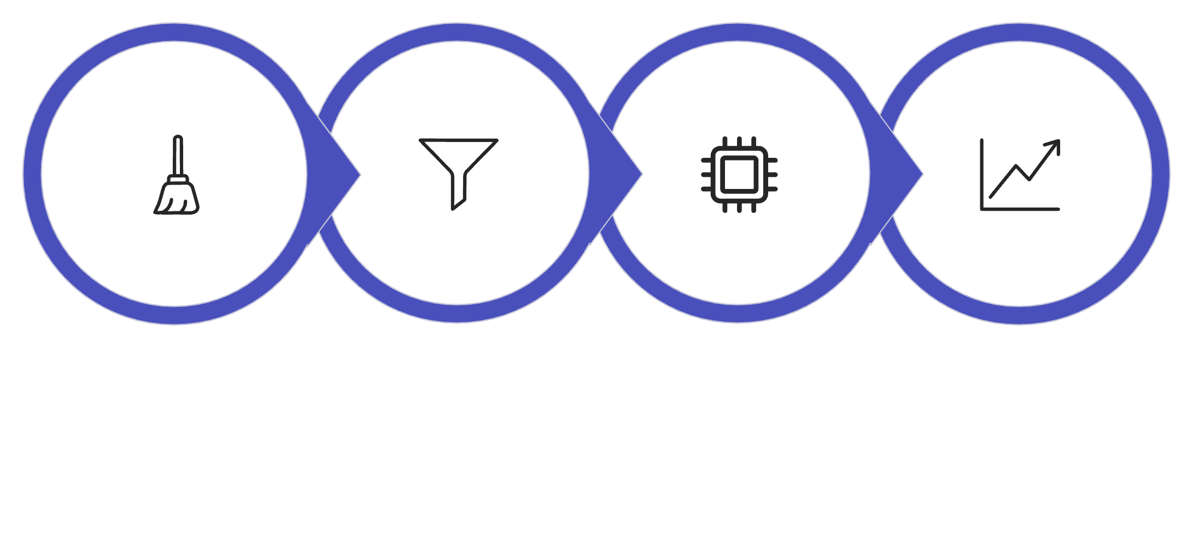




Approach Used: A Comprehensive Methodology
Data Preprocessing
Feature Extraction
Model Training
Evaluation Metrics
Data Preprocessing
Feature Extraction
Soil–weather data is meticulously cleaned using label encoding, scaling, and outlier correction to ensure consistent and reliable model input.
Key parameters such as Nitrogen (N), Phosphorus (P), Potassium (K), pH, temperature, humidity, and rainfall are thoroughly analyzed to identify crucial patterns for crop classification.
Model Training
Evaluation Metrics
Machine Learning models (Random Forest, Logistic Regression) and Deep Learning (LSTM) are rigorously trained on normalized datasets to perform multi-class crop prediction.
Models are comprehensively assessed using accuracy, F1-score, precision, recall, ROC–AUC, and confusion matrix for robust performance comparison.
Exploratory Data Analysis (EDA) using heatmaps, histograms, pairplots, and scatterplots was performed to visualize and understand feature relationships and crop behavior.

Slide 8
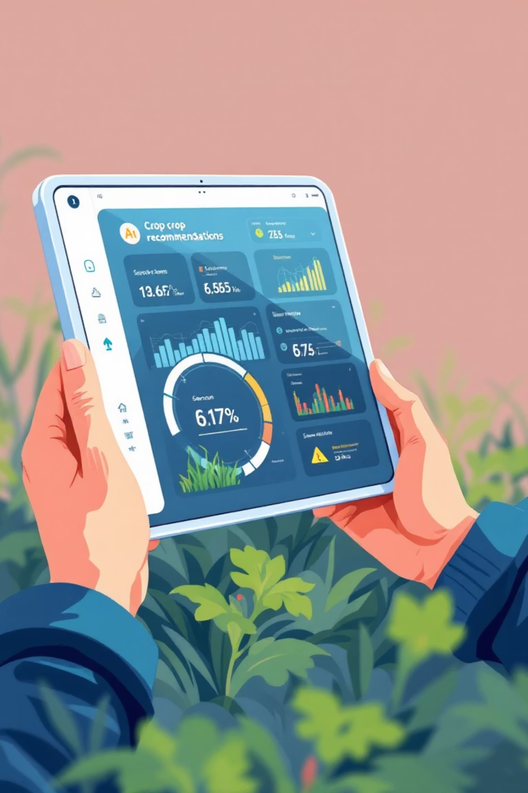
Solution Proved: An Intelligent Crop Recommendation System
Developed an ML-based crop recommendation system leveraging Random Forest for its high accuracy in predictive modeling.
Implemented an LSTM deep-learning model to effectively learn complex temporal patterns from diverse soil–weather features.
Integrated EDA visualizations, including heatmaps and scatterplots, to deepen the understanding of nutrient–crop relationships and enhance model reliability.
Enabled real-time prediction capabilities with a deployable (.h5) model, ensuring immediate and actionable recommendations for farmers.
Designed a scalable framework prepared for future integration with IoT sensors, advanced weather APIs, and precise fertilizer suggestions.

Slide 9
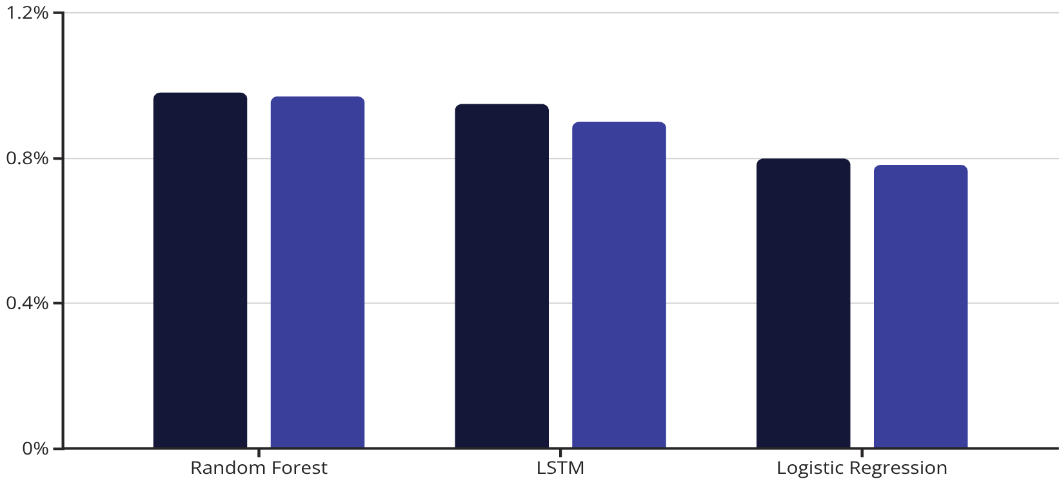
Results and Comparison: Model Performance
Random Forest achieved the highest performance with approximately 98% accuracy and 97% F1-score.
The LSTM model showed strong learning with around 95% training accuracy and 90% validation accuracy, indicating potential for growth with more temporal data.
Logistic Regression served as a baseline, performing lower at approximately 80% accuracy.
Confusion matrix analysis confirmed high prediction accuracy for most crops, with minimal overlap among nutrient-similar crops.
Overall, Random Forest consistently outperformed both LSTM and Logistic Regression due to its superior ability to model complex non-linear soil–weather relationships effectively.
Accuracy
F1-score

Slide 10

Conclusion: Paving the Way for Smart Agriculture
The AI-based crop recommendation system effectively provides precise guidance using comprehensive soil and weather parameters.
Random Forest emerged as the most accurate and reliable predictive model among all evaluated approaches.
While promising, the LSTM model demonstrates a need for more extensive temporal data to fully unlock its performance potential.
Strategic visualization and in-depth analysis significantly enhanced our understanding of intricate nutrient–crop relationships.
This system lays a scalable foundation for future integrations, including IoT sensors, real-time weather APIs, and advanced fertilizer guidance, propelling agriculture into a new era of efficiency and sustainability.

